Slide 1

SOFTWARE TESTING PROJECT GOBUS WEBSITE
By SOFTWARE TESTER
ONL2_SWD6_G3

Slide 2






SOFTWARE TESTING TEAM
AHMED OSMAN ABD EL TAWAB | Ahmedosmanabdeltaweb@gmail.com
AHMED SAYED ABDUALLAH | ahmedsayed12389@gmail.com
Asmaa Mohamed Ahmed Elshafey | Dr.asmaaelshafey201585@gmail.com
Youssef Mustafa Ramadan | 202119331youssef@gmail.com
Mohamed Mahmoud Amen | Mohamedamenmahmoud10@gmail.com
Nada Nasser Shaban Hussein | nn8516319@gmail.com

Slide 3

INTRODUCTION
GoBus is a website for booking intercity bus tickets in Egypt. We chose it because it’s widely used and provides essential services.
Our goal
is to ensure the system is secure, reliable, and performs well under different conditions.

Slide 4
TYPES OF TESTING PERFORMED
API Testing
Database Testing
Manual Testing
Automation Testing
Performance Testing
CI/CD

Slide 5
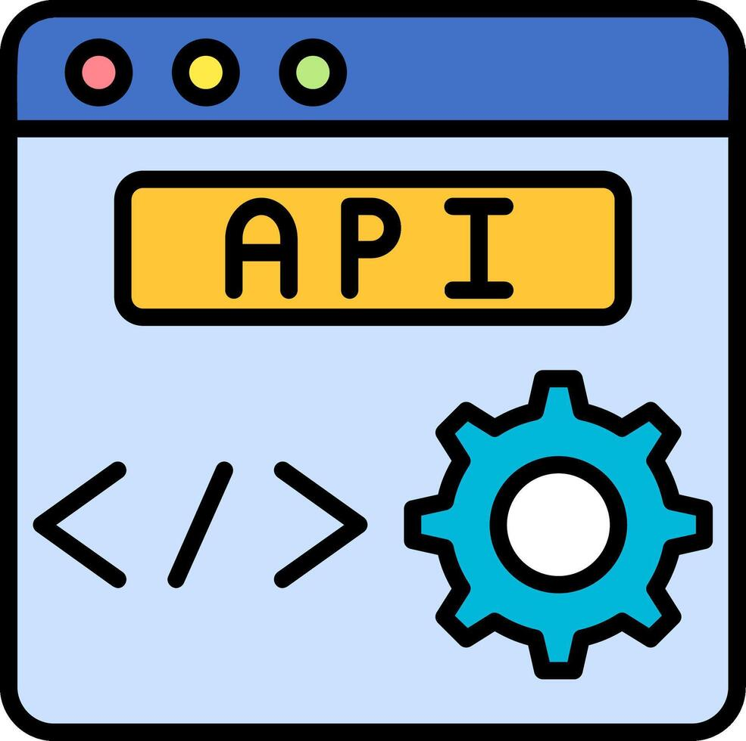
01
API Testing
By postman

Slide 6
API Testing
We used tools Postman to test key API endpoints such as:
Create user
Update user
Get user data
Get All data
Deleted data
We validated :
Status code and Requested Data Validations
Report for API

Slide 7
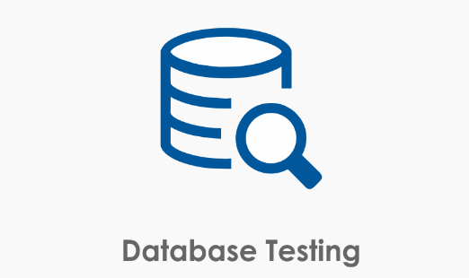
02
Database Testing
MY SQL Branch

Slide 8
Database Testing
We used tool My SQL work branch to test table in data base for user and booking
Data integrity (such booking )
Validity of inserted and update and deleted
Relationships in database table
We validated :
By test SQL Queries
Report for Database

Slide 9

03
Manual Testing
Jira web site

Slide 10
Manual Testing
We manually tested the website's user interface to ensure:
Write test case for many Scenarios like :
Registry and log for user
Buttons and navigation work correctly
Error messages appear when needed Real user scenarios function as expected
We also identified and documented several bugs during the process.
Test case
Bugs Report

Slide 11

04
Automation Testing
Selenium WebDriver

Slide 12
Automation Testing
After validating scenarios manually, we moved to automation.
Tool Used: Selenium Web Driver We created scripts to automatically test key functionalities such as:
Registry
Login
Booking Trip
Home page
Routes
Payment

Slide 13

05
Performance Testing
Apache JMeter

Slide 14
Performance Testing
For example, we tested how the system performs when 100 users try to book at the same time .We measured: Response time Requests per second System stability under load
Performance Report

Slide 15

06
CI/CD Continuous Integration Continuous Delivery
Jenkins

Slide 16
CI/CD
Faster development – deliver features quickly
Find bugs early – automatic testing
Less manual work – auto build & deploy
Stable releases – fewer errors in production
Better teamwork – clear process for dev & testers

Slide 17
Documentation For Project
URL web site
https://go-bus.com/?lang=en
URL test API post name
https://.postman.co/workspace/My-Workspace~d4ff0016-9ba3-42ae-8b33-16ef3e6ce4a2/collection/42565043-04fe1231-db69-4ea2-8437-19a1fc94fe37?action=share&creator=42565043
URL Jira go-bus project
https://ahmedosmanabdeltaweb.atlassian.net/jira/software/projects/GW/boards/4?atlOrigin=eyJpIjoiZjUyYjllMTU0ODE2NGFjYTk0YTEwNTI4NzhlOGQ0MDUiLCJwIjoiaiJ9
URL API End point
https://retoolapi.dev/nfnSAn/data
URL Repo for Git hub Project
https://github.com/Ahmedosman2020/Graduation-project

Slide 18
THANKS!
Do you have any questions?
Software testing Team

